Slide 1
How to use PHP with a MySQL Database
Adding Records

Slide 2
Objectives
How to enter data into a MySQL table.
Use the INSERT command to add rows.
Testing with Contacts database

Slide 3
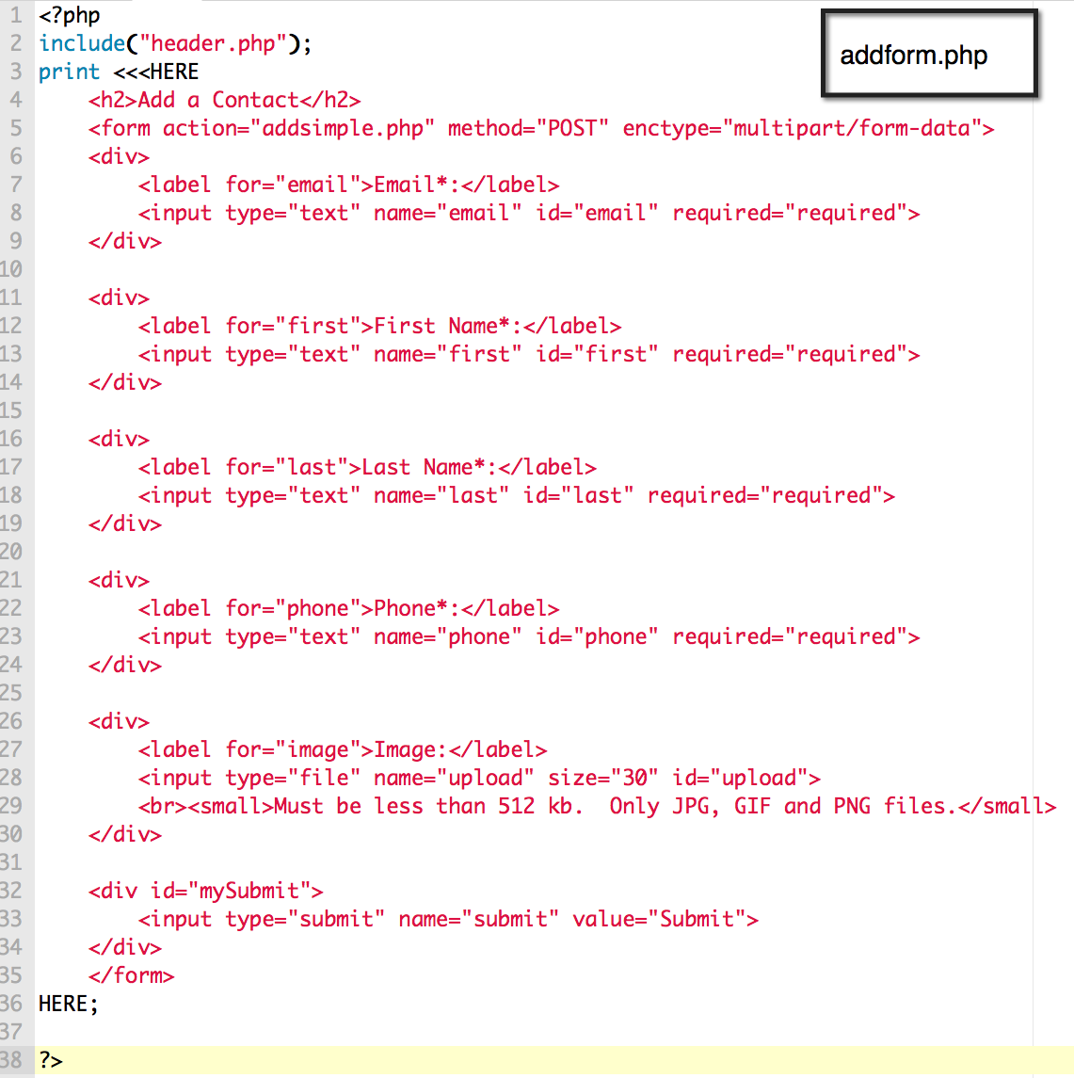

Slide 4
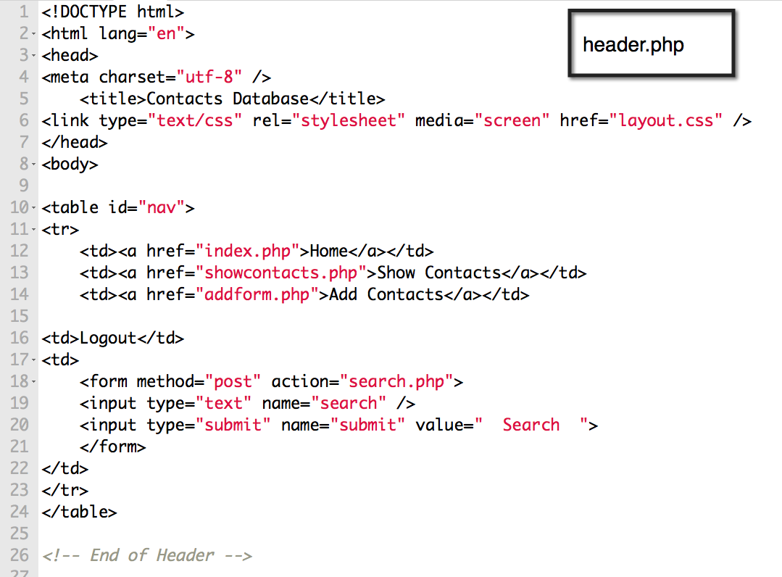

Slide 5
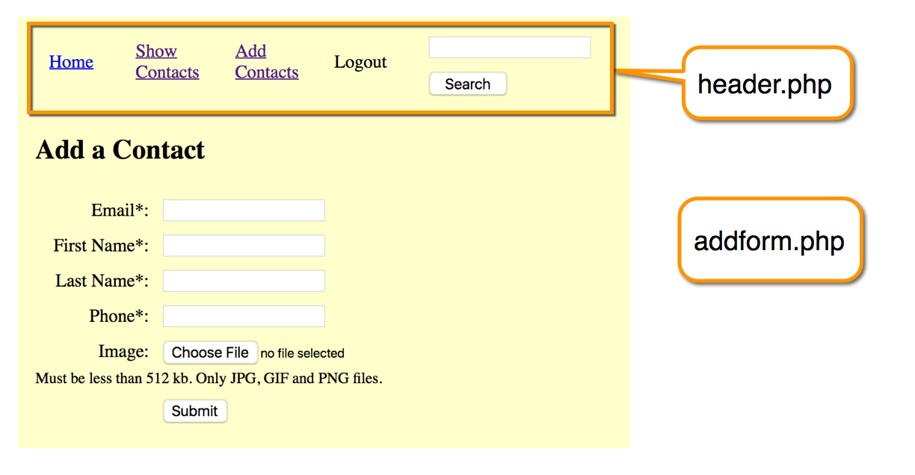

Slide 6
The INSERT Command
Adds a new row to a table.

Slide 7
Adding Data in PHP
Make a connection to the database.
Create a safe query.
Use it as the right side of an assignment.
Run the query.
Display a confirmation.

Slide 8
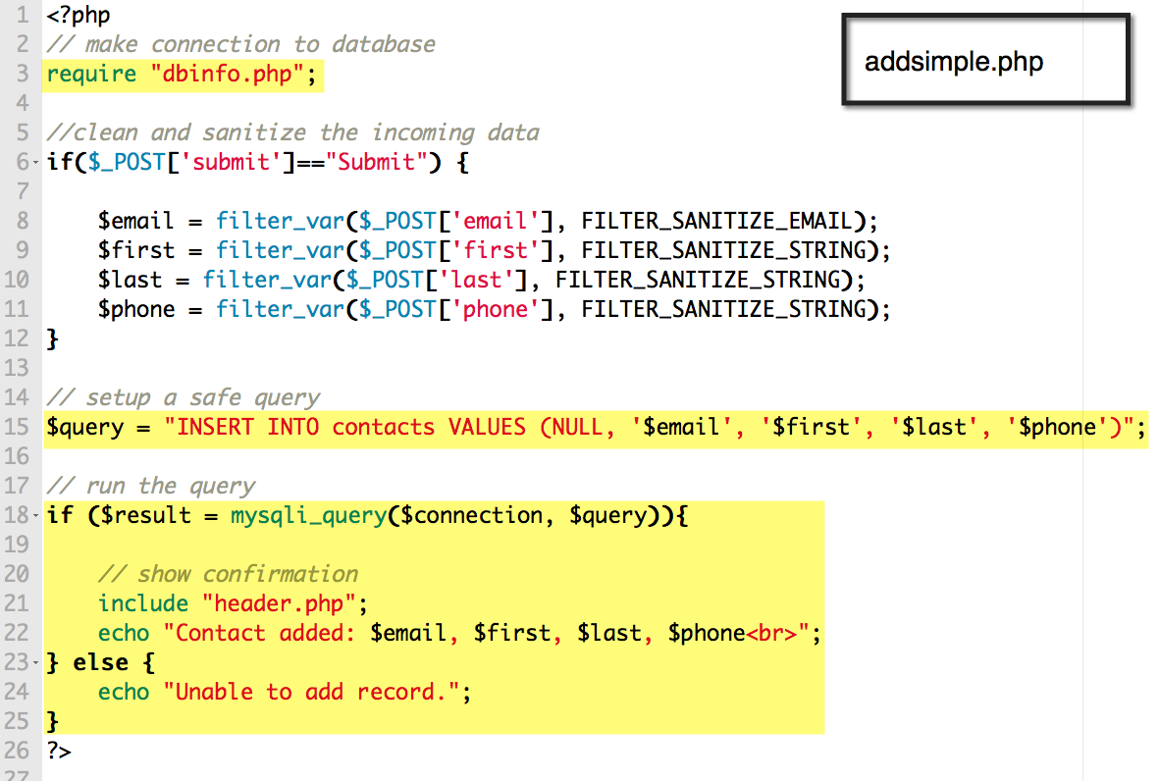
Upload and test by going to addform.php.
Make sure your dbinfo.php and showcontacts.php files are in the same directory.
Try adding new contacts and check that they are in showcontacts.php.

Slide 9
Handling AUTO_INCREMENT
If a field has the AUTO_INCREMENT attribute, MySQL automatically assigns the next number.
Assign a 0, empty quotes or the keyword NULL

Slide 10
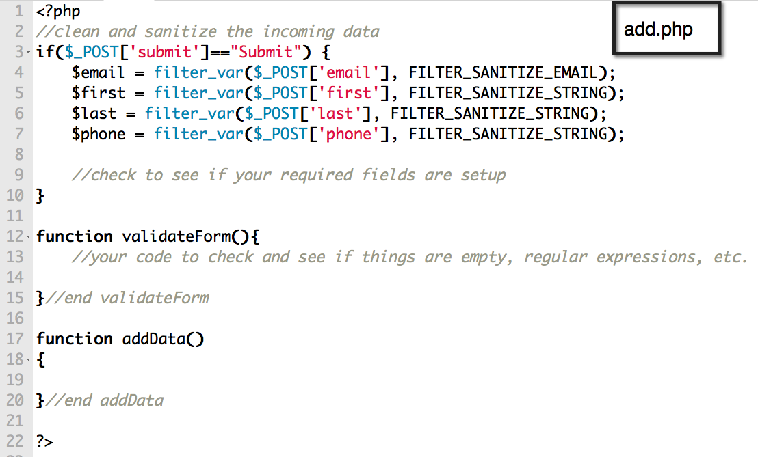

Slide 11
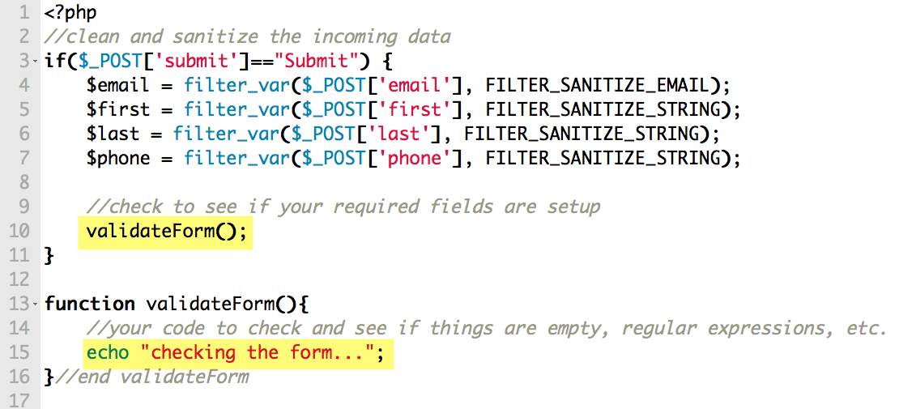
add.php

Slide 12
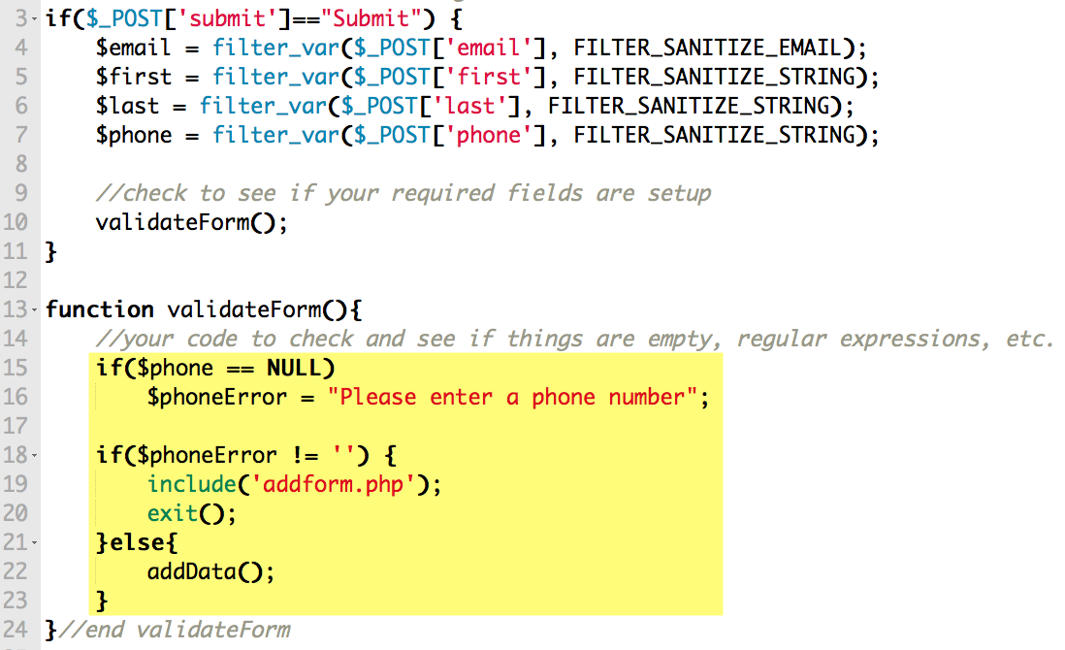
add.php

Slide 13
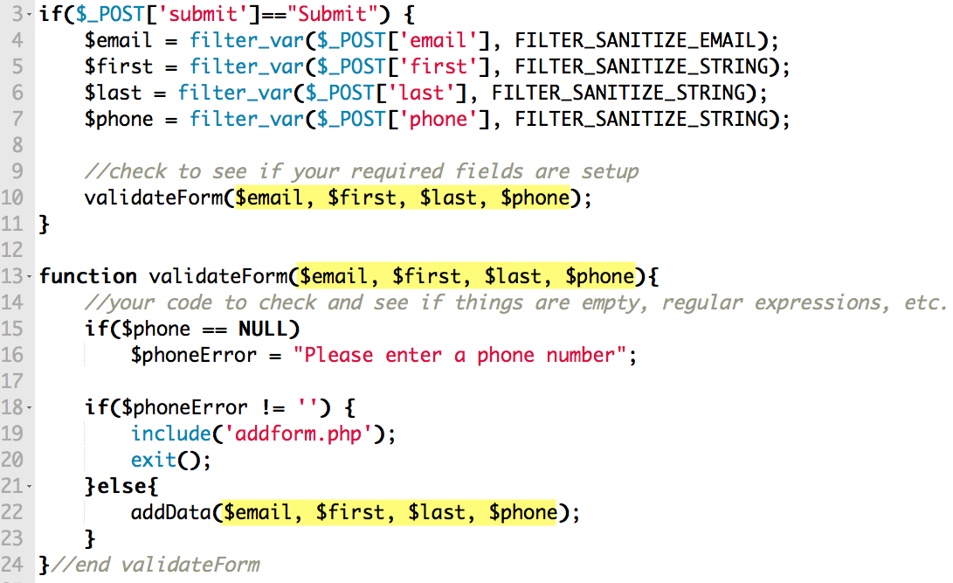
add.php

Slide 14
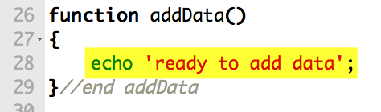
add.php

Slide 15
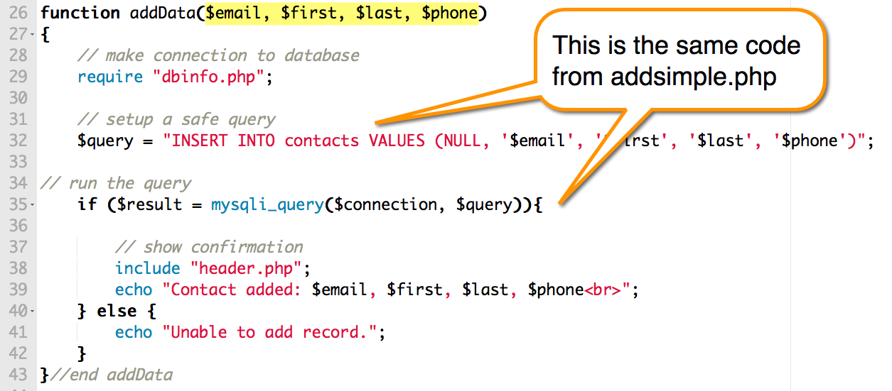
add.php

Slide 16
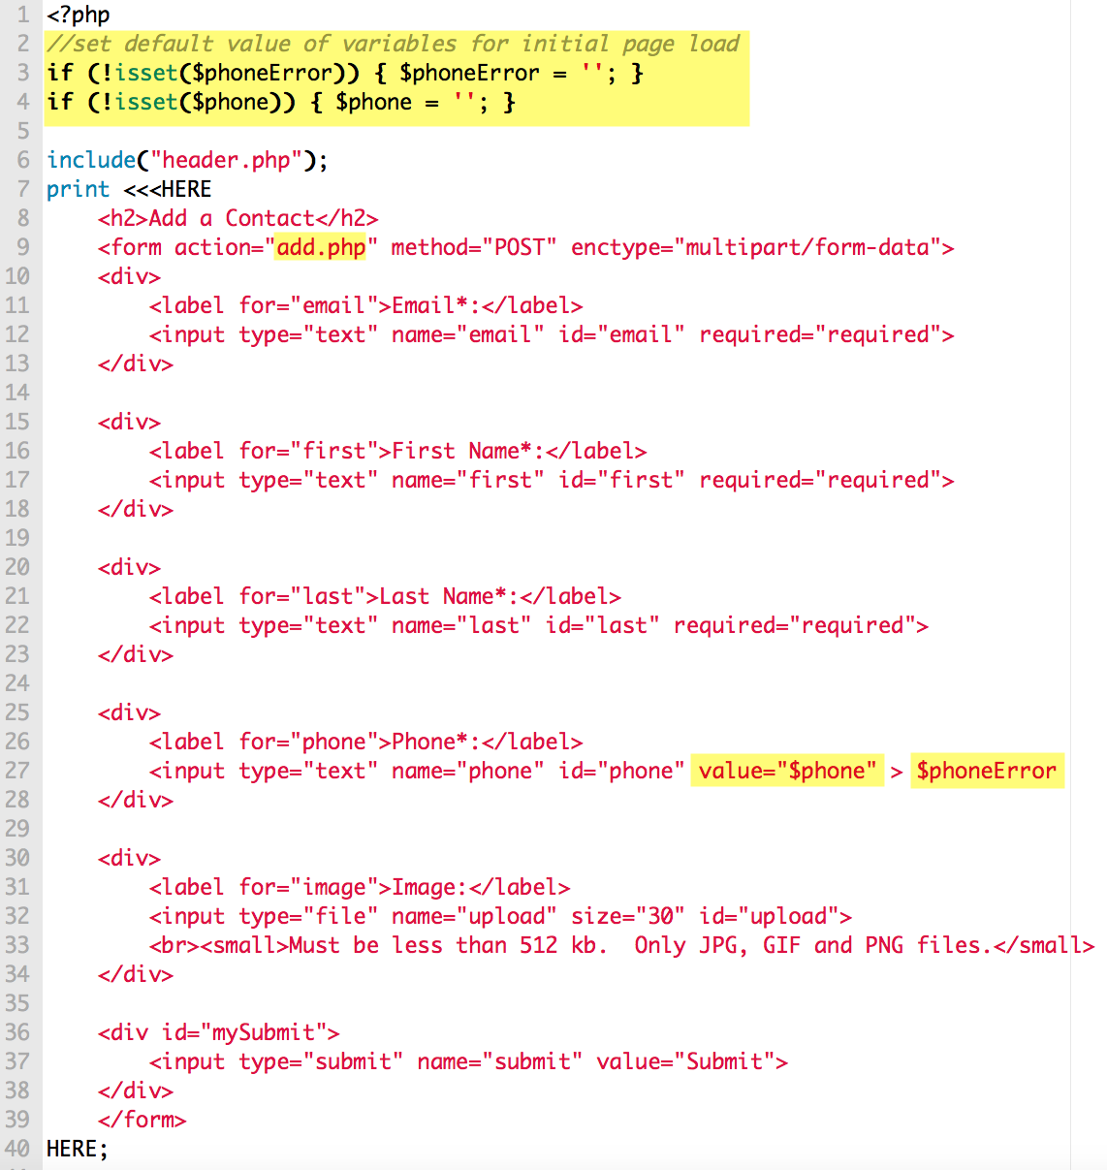
addform.php

Slide 17
SCRUD Lab
Search
Create
Read
Update
Delete
See if you can connect to your Aliens Database and add abductions as records in your table.
You must still keep the validation – make sure required fields are filled in, uses your regular expressions, shows error messages, sticky form.
This is the Create component of the lab.

